Slide 1

Global Insurance Analytics using MySQL
An End-to-End Analytical View of Policies, Customers, Claims & Payments
By
Devi Konni

Slide 2

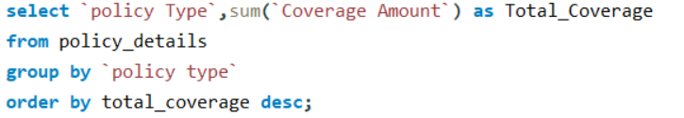
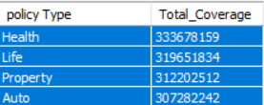
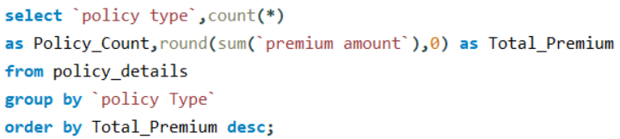
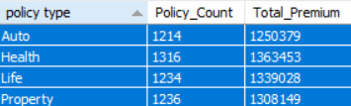
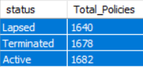
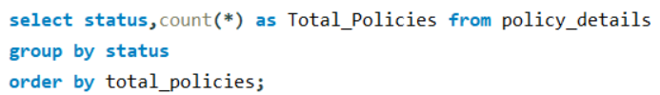
🌍 Global Insurance Policies Overview
📊 Coverage Split by Policy Type
Total coverage distribution among different policy types
💰 Premium Insights by Policy Type
Policy count and total premiums collected per type
📄 Status-Wise Policy Distribution
Overview of policy status like Active, Lapsed, etc.

Slide 3
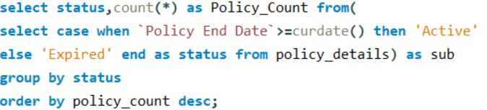
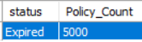
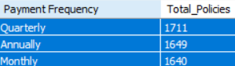
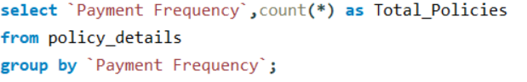
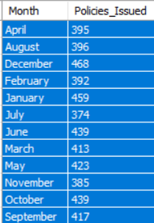
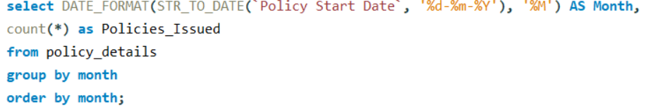
🕒 Active vs. Expired Policies (Dynamic Status Check)
Track current active and
expired policies as of today
Distribution of policies
based on payment cycles
🔁 Payment Frequency Patterns
New policies issued over
each month to spot trends
📅 Monthly Policy Issuance Trend

Slide 4
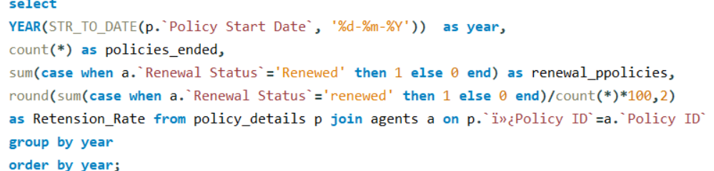
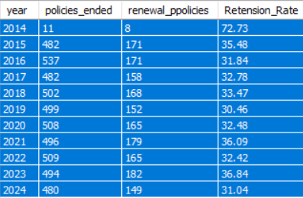
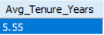
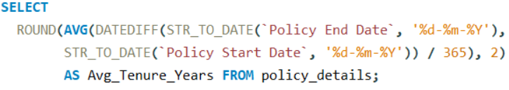
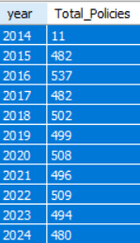
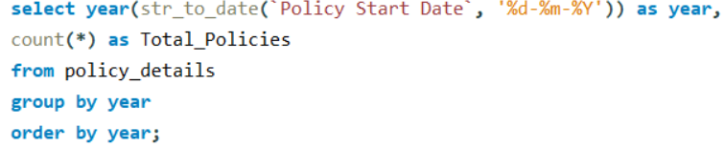
Track yearly renewal and retention rates
🔄 Policy Renewal Performance by Year
How long customers usually hold a policy
📏 Average Tenure of Policies (in Years)
Annual trend of policy issuance
📈 Policy Growth by Year

Slide 5
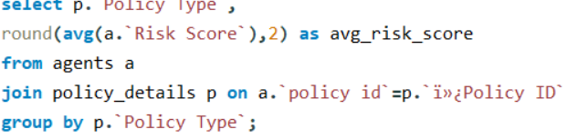
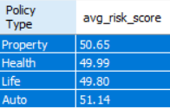
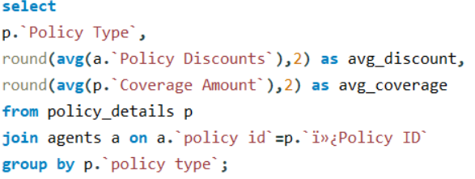
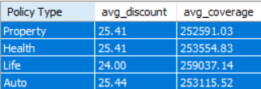
⚠️ Risk Score Analysis by Policy Type
Average risk score linked with each policy category
🎯 Discounts vs. Coverage Insights
Compare average discounts and coverage across policy types

Slide 6

💡 Insights & Key Findings
📊 Top Policy Types Dominate A few policy types contribute the most to total premium and coverage.
🟢 Majority Policies Are Active Most policies are still within their term; however, expired policies highlight renewal gaps.
📆 Policy Sales Show Seasonal Trends Certain months consistently see higher policy issuance.
🧮 Short Average Policy Tenure Indicates scope to increase customer lifecycle and satisfaction.
⚠️ High-Risk Policies Identified Risk scores vary by policy type—valuable for targeting.
💸 Monthly Payments Preferred Most policies use monthly frequency, affecting cash flow stability.

Slide 7

🎯 Recommendations & Conclusion
🔄 Boost Retention Campaigns Engage customers before expiry with personalized renewal offers.
📢 Promote High-Premium Policy Types Focus marketing on top-performing policies for better returns.
✂️ Optimize Discount Strategies Revisit high-discount policies to protect profitability.
📆 Encourage Annual Payments Offer incentives for annual payment plans to improve retention.
🧠 Target High-Risk Segments Wisely Use insights for tailored coverage or additional services.
🕐 Leverage Seasonal Peaks Align promotions with months showing higher sales trends.

Slide 8
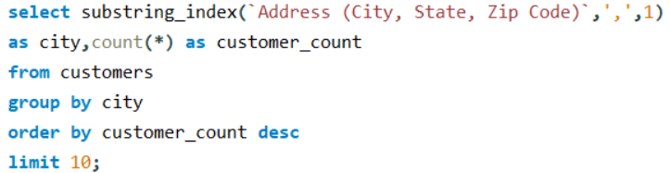
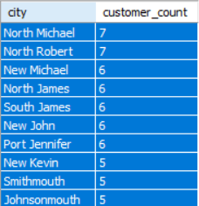
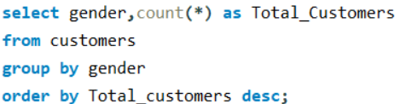
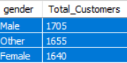
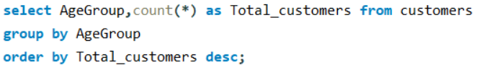
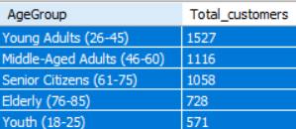
🧑‍💼 Customer Demographics
Distribution of customers across top-performing cities
🏙️ Top 10 Cities by Customer Count
🚻 Customer Distribution by Gender
Male vs Female split among total customers
👶👵 Customer Distribution by Age Group
Which age groups are most insured

Slide 9
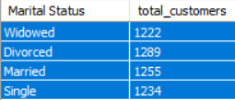

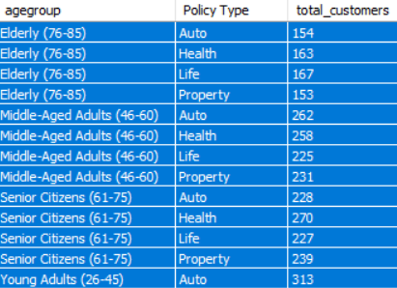
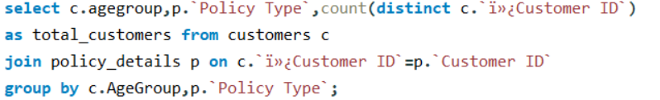
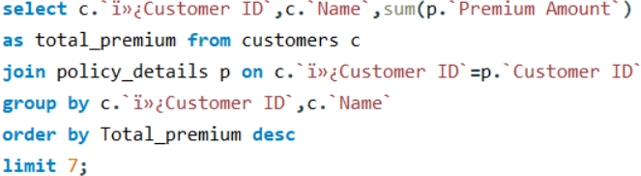
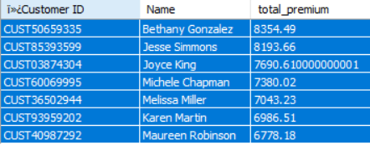
Customers contributing the highest premium amounts
Understanding the marital status of policyholders
💍 Distribution by Marital Status
🔄 Policy Type Preference by Age Group
Which age groups prefer which policy types
💎 Top 7 Customers by Premium Paid
Customers contributing the highest premium amounts

Slide 10
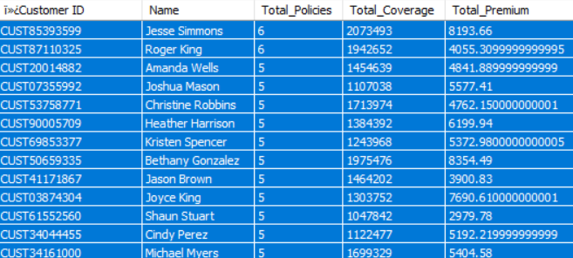
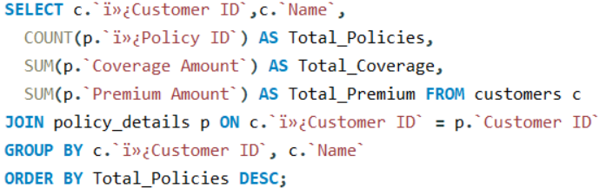
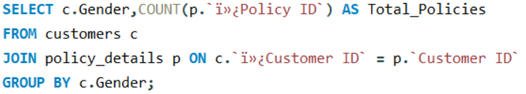
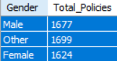
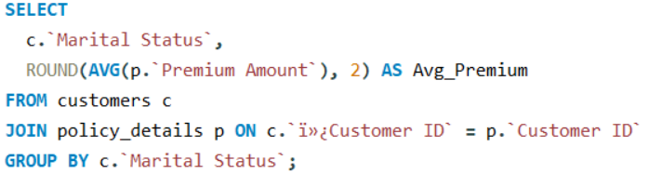
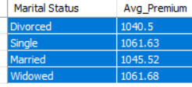
Customers contributing the highest premium amounts
📄 Customer Policy Portfolio Overview
Total policies, coverage, and premium per customer
🚻📄 Policy Count by Gender
Total number of policies held by each gender
💍💰 Average Premium by Marital Status
How marital status affects average premium value

Slide 11
💡 Insights & Key Findings
🏙️ Urban-Centric Customers Majority are from metro cities, showing strong urban outreach.
🚻 Balanced Gender Split Male and female customers are nearly equal.
👶👵 30–50 Age Group Leads Most customers are in the middle-age, earning bracket.
💍 Married Customers Dominate Insurance decisions appear family-driven.
💎 Few Drive Most Premiums Top customers contribute high premium amounts.
🔄 Age-Based Policy Choices Policy preferences differ by life stage.

Slide 12
🎯 Recommendations & Conclusion
📍 Expand Rural Outreach Target smaller cities to grow customer base.
🧑‍🎓 Design Age-Specific Plans Introduce youth and senior-focused policies.
👫 Highlight Family Benefits Use messaging that appeals to married individuals.
💼 Reward High-Premium Clients Provide exclusive perks for top-paying customers.
🚻 Customize by Gender Use tailored campaigns for male and female audiences.
📊 Apply Segmentation Strategy Leverage data to deliver personalized offerings.

Slide 13
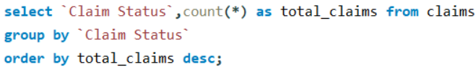
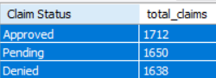
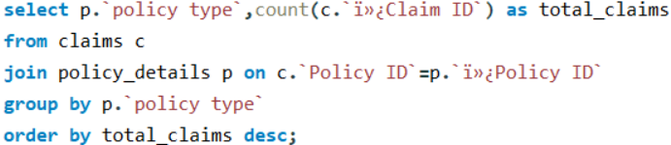
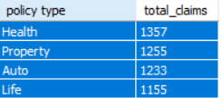
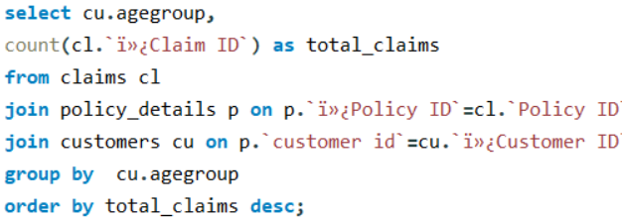
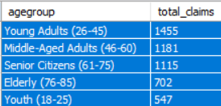
🧾 Claims Overview
📊 Claim Status Distribution
Analyzing how claims are categorized (e.g., Approved, Rejected, Pending).
🧾 Claims by Policy Type
Examining the number of claims based on different insurance policy types.
👨‍👩‍👧‍👦 Claims by Age Group
Identifying which customer age groups are filing the most claims.

Slide 14
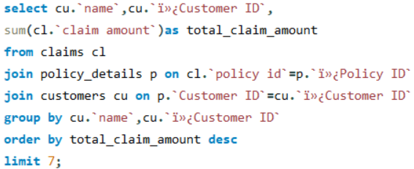
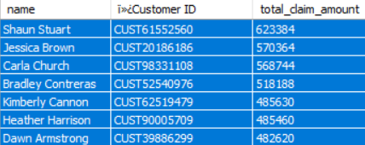
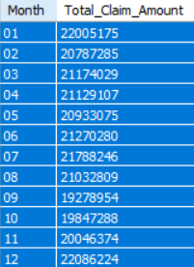
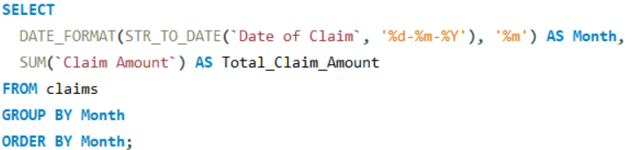
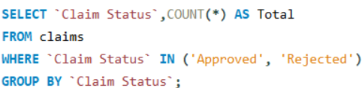

🏆Top 7 Customers by Claim Amount
Customers with the highest total claimed amount.
Tracking total claim amount filed each month to identify seasonal trends.
📈 Monthly Claim Amount Trend
✅❌ Approved vs. Rejected Claims
Comparing the number of approved and rejected claims.

Slide 15








💵Average Claim Amount by Policy Type
Policy types with highest average claim values.
⏱️ Average Claim Settlement Duration
How long does it typically take to settle a claim?
Most costly reasons for filing claims.
🎯 Top 10 Reasons for Claims by Amount
Most costly reasons for filing claims.
🌆 Claims Filed per City

Slide 16
💡 Insights & Key Findings
✅ Most claims are Approved, but many are still Pending or Rejected.
🏥 Health and 🚗 Auto policies have the highest claim volumes.
👵 Middle-aged and senior customers file the most claims.
💰 Few customers account for high claim amounts.
📅 Claims spike in certain months—likely seasonal trends.
⚖️ Approval to Rejection ratio shows room for process improvement.
🏠 Property policies have higher average claim amounts.
⏳ Average settlement time needs reduction.
🎯 Accident, Illness, Theft are top claim reasons.
🌆 Urban areas see more claims filed.

Slide 17
🎯 Recommendations & Conclusion
⚙️ Streamline claim processing to reduce delays.
👥 Focus on high-risk age groups for better risk management.
🕵️ Monitor top claimants for potential fraud.
📈 Prepare for seasonal claim surges.
📉 Cut down settlement time for better satisfaction.
🧭 Launch city-specific initiatives.
🔍 Review and clarify claim rejection reasons.

Slide 18






💳 Payments & Revenue Overview
💰 Total Revenue by Payment Type
Summarizes overall payments received via different methods.
Shows how much revenue is generated by each insurance policy type.
🧾 Total Revenue by Policy Type
Tracks monthly fluctuations in revenue to spot seasonal trends.
📈 Monthly Revenue Trend

Slide 19






Highlights customer preference for different payment methods.
🏦 Payment Method Distribution
Monitors revenue trends across financial quarters.
📊 Quarterly Revenue Trend
Breaks down total payments made by each customer, categorized by payment status.
👤 Total Payments by Customer & Status

Slide 20






Identifies policies with the highest average payments.
🏅 Top 10 Policies by Average Payment
🧑‍💼 Top 10 Paying Customers
Lists the customers who have contributed the most revenue.
⚠️ Failed Payments by Method
Detects risk-prone or problematic payment methods.

Slide 21




🔁 Policy Payment Frequency
Analyzes how frequently customers are paying for their policies.
📆 Yearly Revenue Overview
Shows overall revenue growth or decline on a yearly basis.

Slide 22
💡 Insights & Key Findings
💳 Credit Card & Net Banking dominate payments.
📦 Health & Life policies drive most revenue.
📅 Revenue peaks in specific months/quarters.
🧑‍💼 Few customers account for high payments.
❌ Failed payments mainly from select methods.
🔁 Annual payment frequency is most common.
📉 Some policies show low average payments.

Slide 23
Conclusions Recommendations

Slide 24
✅ Conclusions
👥 Majority of policyholders are adults and seniors, with males leading in number.
🏙️ Urban areas have higher customer and claim engagement than rural areas.
📅 Annual and quarterly payment plans are most common.
💼 Health and Life Insurance are the top purchased and highest revenue-generating policy types.
✅ Most claims are approved, but there's noticeable settlement delay.
📊 A few customers generate high claim volumes, suggesting potential risk concentration.
🏙️ Certain cities and months show peak claim and payment activity.
💳 Credit Card and UPI are preferred payment methods.
⚠️ Failed payments are present, mostly linked to specific methods.
💰 A small number of customers contribute to a large portion of total payments.

Slide 25
🎯 Recommendations
🎯 Launch targeted marketing by age, gender, and location.
🌆 Focus campaigns in urban and high-claim areas.
📢 Promote high-performing policy types like Health and Life Insurance.
⏳ Reduce claim settlement time with better internal workflows.
🧾 Monitor high-claim customers closely for risk management.
📅 Use monthly and city-wise trends to time promotions smartly.
💸 Offer incentives for digital payments to reduce failures.
🔁 Encourage flexible payment plans for better customer retention.
📍 Track and boost performance in top revenue-generating zones.

